Slide 1


IST652 – final project COVID-19 state-wise tracking in the United states
BY: Ananth Adisesh

Slide 2
Introduction
COVID-19 outbreak was first reported in Wuhan, China and has spread to more than 50 countries.
Naturally, a rising infectious disease involves fast spreading, endangering the health of large numbers of people, and thus requires immediate actions to prevent the disease at the community level.
We track three related kinds of data that can help us understand the US outbreak and the disease itself: testing data, hospitalization, outcomes data, and mortality rate.
This project is done to analyze and understand the spread of the disease. This data can further be enhanced by performing data cleaning, visualization, machine learning and statistical modelling techniques as well as model performance evaluation techniques which can help further understand the data and the spread of the disease across the states in the United States.

Slide 3
Data pre-processing and preparation
This project uses data cleaning techniques help in reducing the error and save time in performing analysis.
In this project, the methods used are:
Checking for duplicate rows and removing them.
Replacing the null values with zeroes.
Converting the data of attributes from one data type to another.
Removing the unrequired outliers.

Slide 4
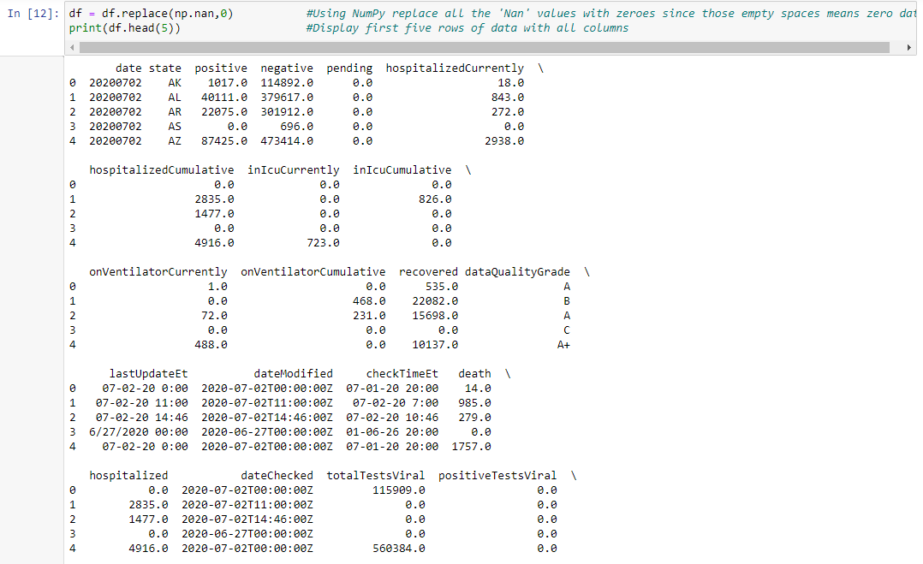
Data pre-processing and preparation

Slide 5
Data visualization and exploratory data analysis
Data visualization is done to represent data in a graphical or pictorial format.
Data visualization helps understand the data better.
Exploratory data analysis helps us understand the statistical aspect of the data. It also helps understand the descriptive statistics of the dataset.

Slide 6
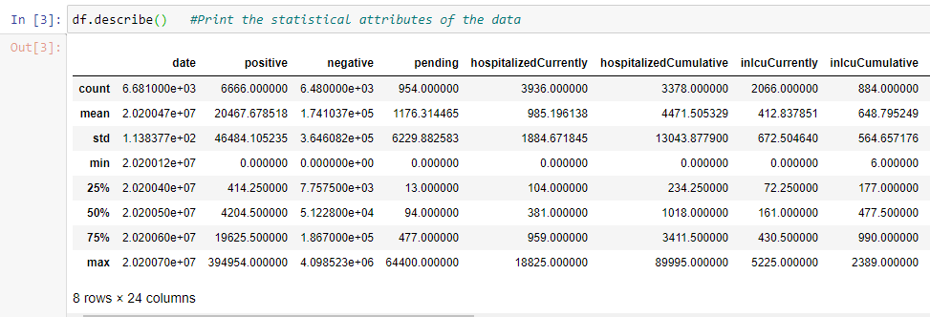
Data visualization and exploratory data analysis(CONTD.)

Slide 7
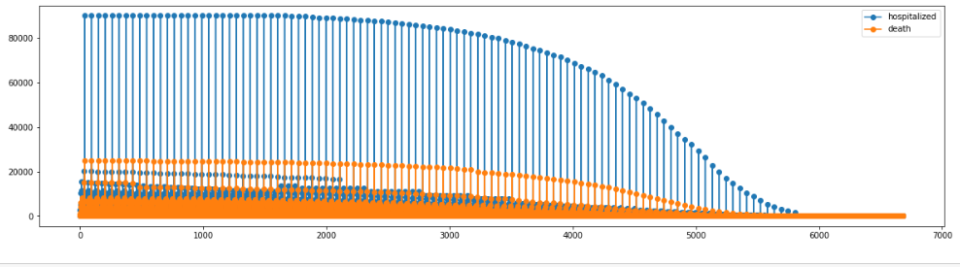
Data visualization and exploratory data analysis(CONTD.)

Slide 8
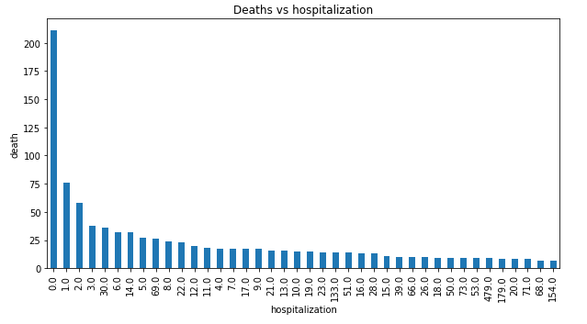
Data visualization and exploratory data analysis(CONTD.)

Slide 9
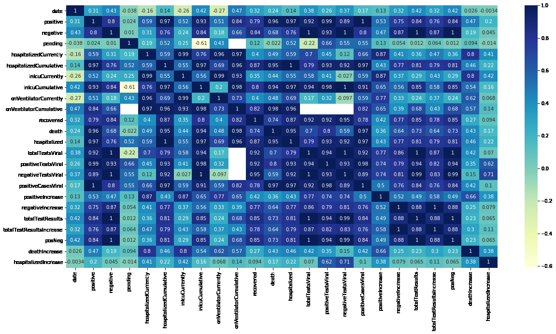
Data visualization and exploratory data analysis(CONTD.)

Slide 10
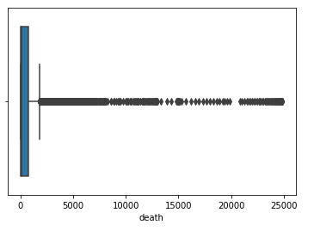
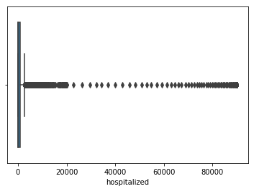
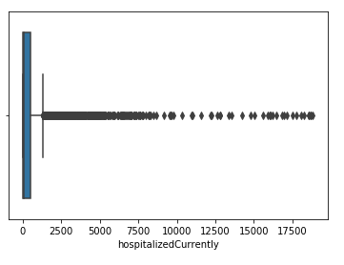
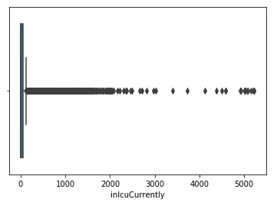
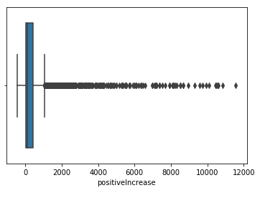
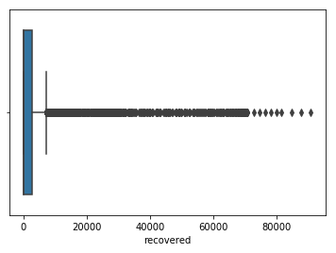
Data visualization and exploratory data analysis(CONTD.)

Slide 11
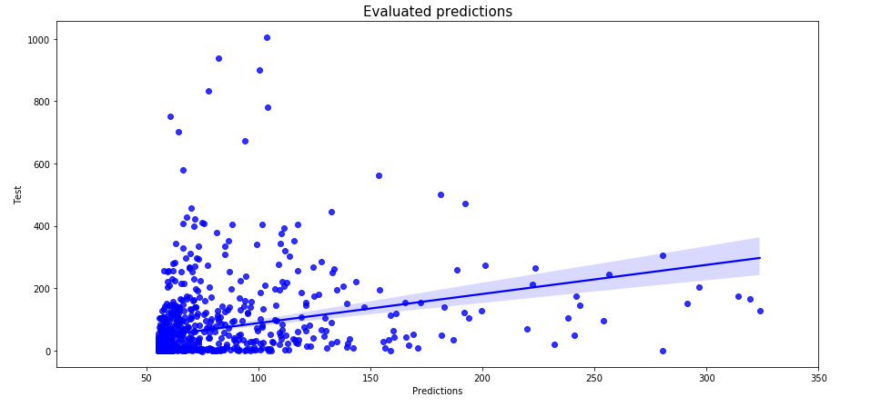
Linear regression modelling

Slide 12
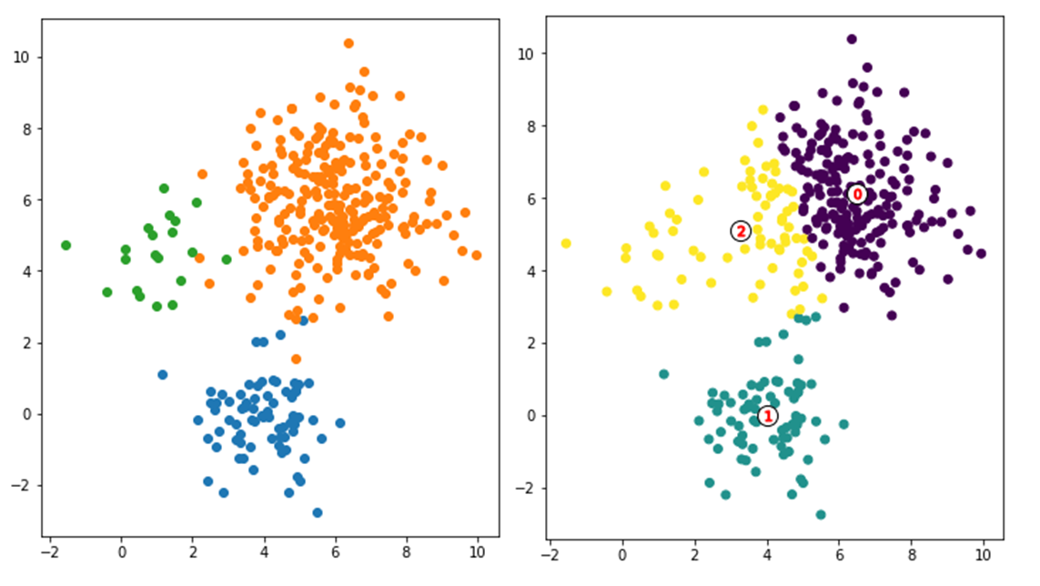
K-means clustering

Slide 13
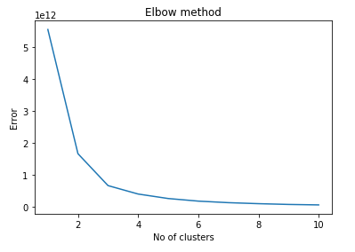
K-means clustering

Slide 14
THANK YOU

